Slide 1
Git – Other useful stuff
Moritz Flüchter

Slide 2
Content
Metafiles
Pull requests in GitHub
Other git commands

Slide 3
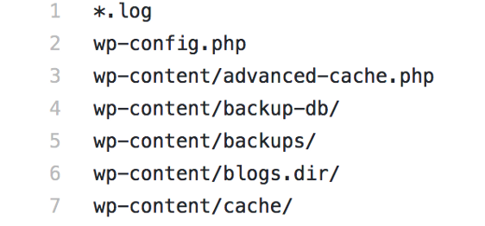
Metafiles
.gitignore
specifies which files git should ignore for adds/commits
contains linux-like filenames to ignore
https://miro.medium.com/max/1838/1*NcXm-TAJgSuYurkWnxs3Pg.png

Slide 4
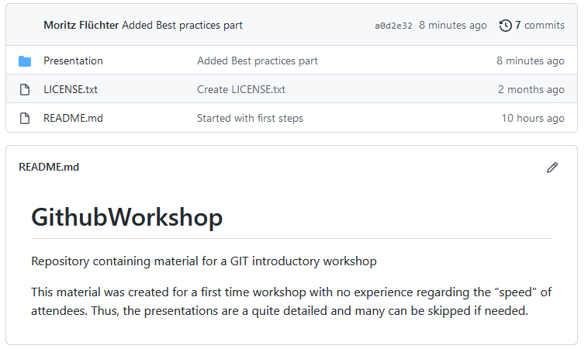
Metafiles
README.txt
uses markdown
should contain important infroamtion (e.g. setup, requirements, usage, …)
Is shown on repository website

Slide 5
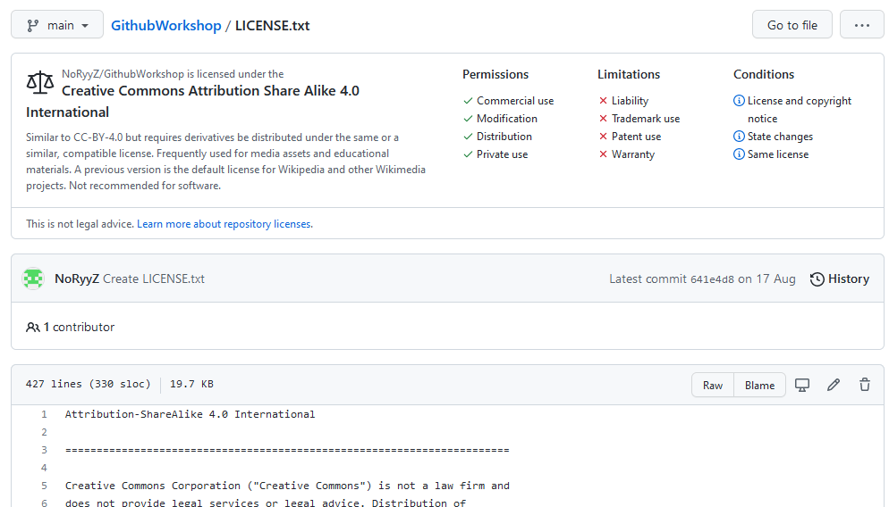
Metafiles
LICENSE.txt
raw text
Contains license rights regarding usage of the code

Slide 6
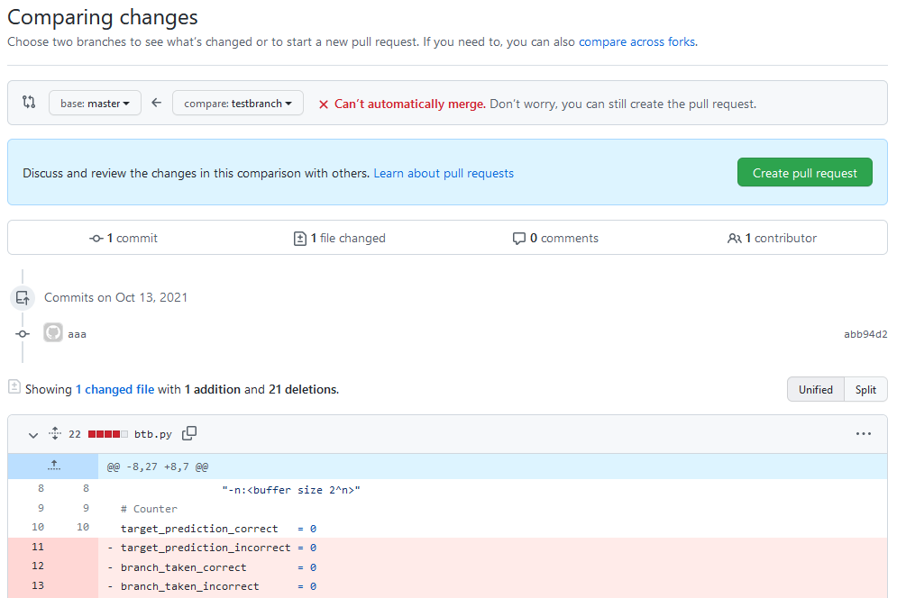
Pull requests in github
Request to merge a branch into another
Request has to be approved by maintainer
Often only way to merge branches in order to prevent rogue developers :)

Slide 7
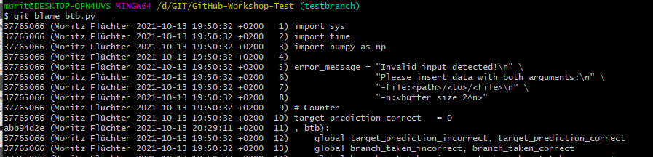
Other git commands
Git blame
Find out who changed a line of code:
$ git blame [filename]

Slide 8
Finally
www.google.com
www.stackoverflow.com
duckduckgo.com
…
If you dont know how to do something, search for it ☺

